Slide 1
Executables and Paths

Slide 2
Lesson Objectives
Understand how executables and pathing influence operating system behavior
Identify which file (process) is being called when a command is executed
Modify a PATH environment variable

Slide 3
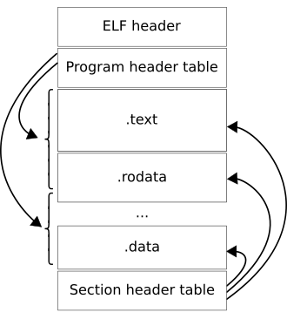
What is an Executable?
A binary file (typically)
Contains instructions and data
The operating system loads the instructions and data and creates a process to track the state of the executable
The process gets (eventually) scheduled for execution on the CPU
Notes:
https://en.wikipedia.org/wiki/Executable_and_Linkable_Format
https://en.wikipedia.org/wiki/Portable_Executable

Slide 4
How do we run Executables?
Double-click an icon
At startup
Type a command on the command-line
Operating system handles the rest

Slide 5
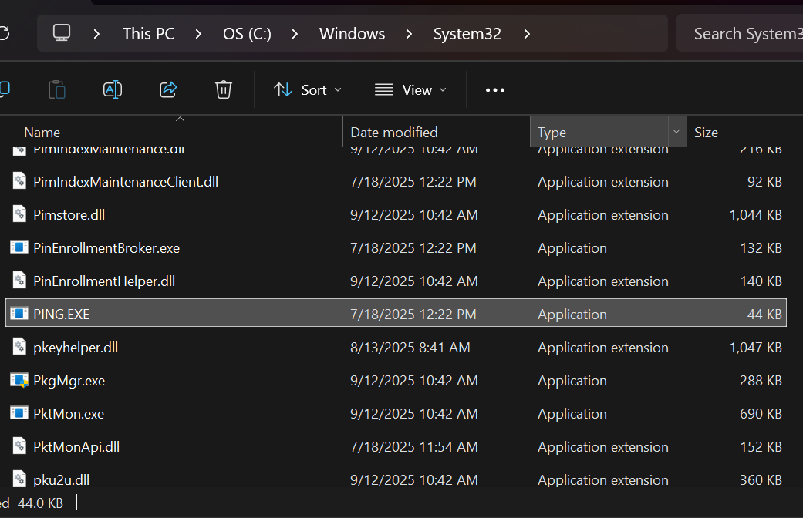
Where are executables located?
Typically stored on the local file system
The OS needs to know the location so it can process/load the file contents
In theory, we need to type the full path to the executable
Why don’t we though?
/bin on Linux among others

Slide 6
How are executables found?

Slide 7
What is the PATH?
A list of directories to find executables within
The OS will search directories in order
The first match is the executable that is executed

Slide 8
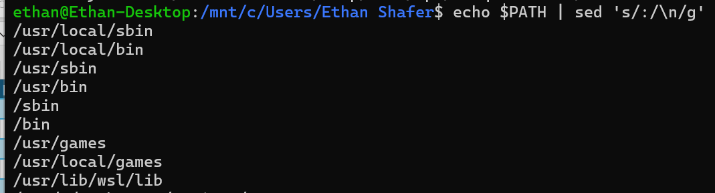
Look to the PATH
Windows
Linux
System Properties → Environment Variables → Path
Powershell: $env:path
Cmd: set path
What does it look like?
System and user level
echo $PATH
Or…
echo $PATH | sed 's/:/\n/g'
Notes:
https://www.gnu.org/software/sed/manual/sed.html

Slide 9
What if something isn’t on the PATH?
What do you think happens?

Slide 10
A Side Note: Environment Variables
Variables maintained at the OS level
Typically accessed as strings (but obvi can store numbers or other values as strings)
Can be modified and adjusted on the fly
PATH is just one of many typical variables

Slide 11
Virtual Environments

Slide 12
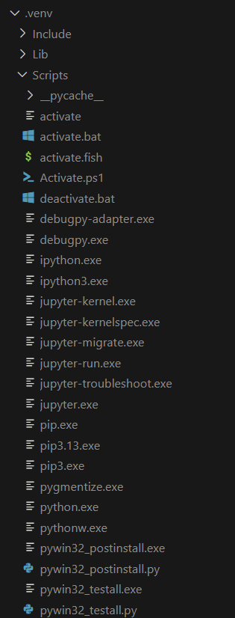
Inspecting the virtual environment
Built to help manage “dependency hell”
Creates a folder inside your directory
Copies over executables and “site-packages”
Creates some scripts and config for later use
Comes with its own trials and tribulations
Inspect the contents of the Scripts folder, what do you notice?
Create a venv and inspect the activate.bat file, what do you notice? (look for manipulating the path variable)

Slide 13



…can get you in trouble
VS Code
Notes:
Top one is the version of python pulled from PATH
Middle one is the active interpreter that VS Code is using to do syntax highlighting
Bottom one is the virtual environment’s interpreter that is being used by the Jupyter Notebook kernel
All three are pointing to different python executables!

Slide 14
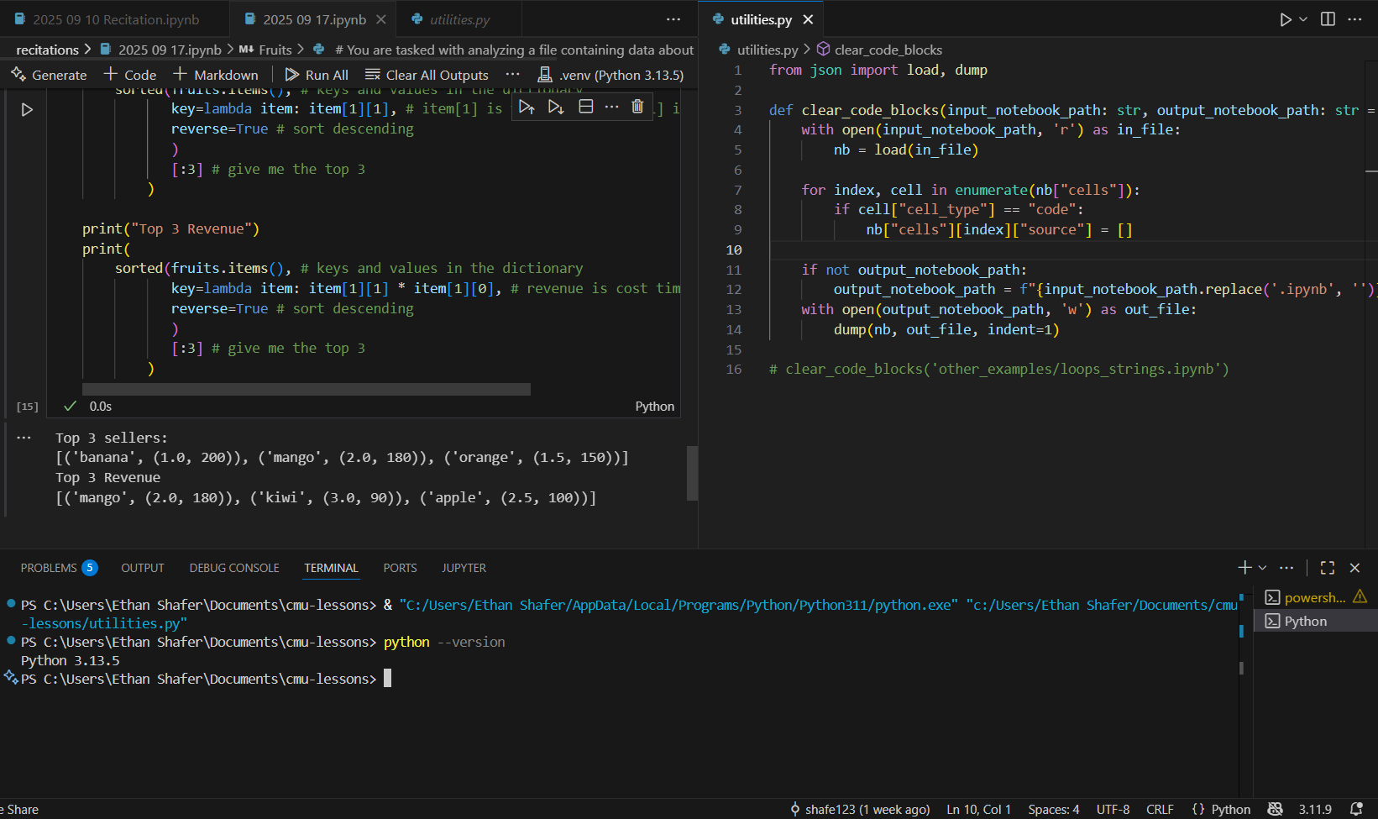
Virtual Environment…
Active Interpreter…
…PATH
Notes:
A larger view of the previous screenshots
Read the command that VS Code enters for you when you press the play button (in blue text in the bottom terminal). They type the full path to the exe and then the full path to your python script.
Note that even though python --version shows 3.13.5 and the venv also shows 3.13.5, they’re actually both pointing to separate executable files.

Slide 15
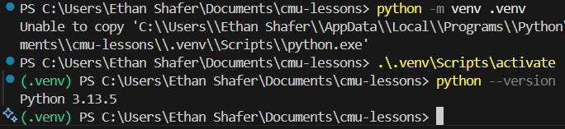
A bonus
In this example, the first command (“python –m venv .venv”) creates a virtual environment with the version of python that is first found on the PATH.

